Slide 1
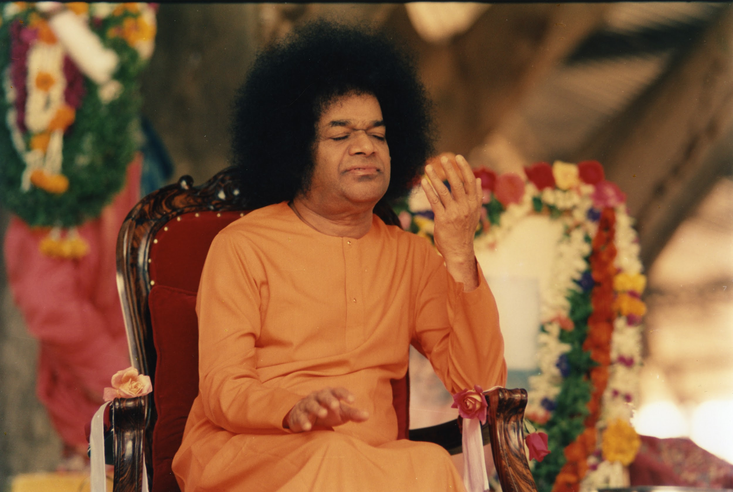

Slide 2
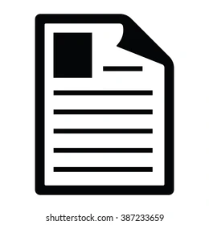

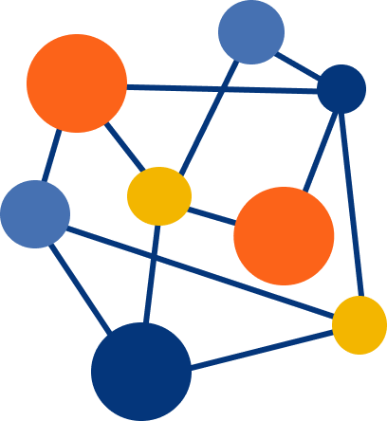
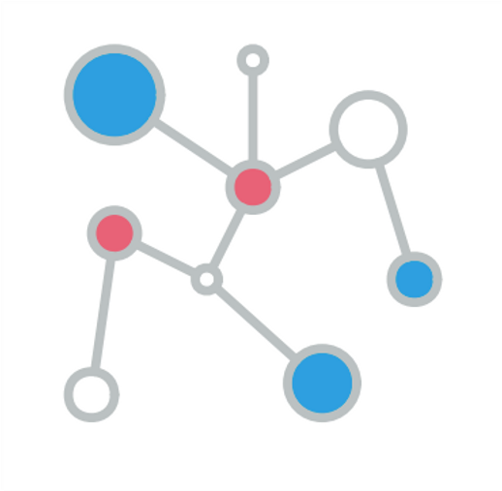
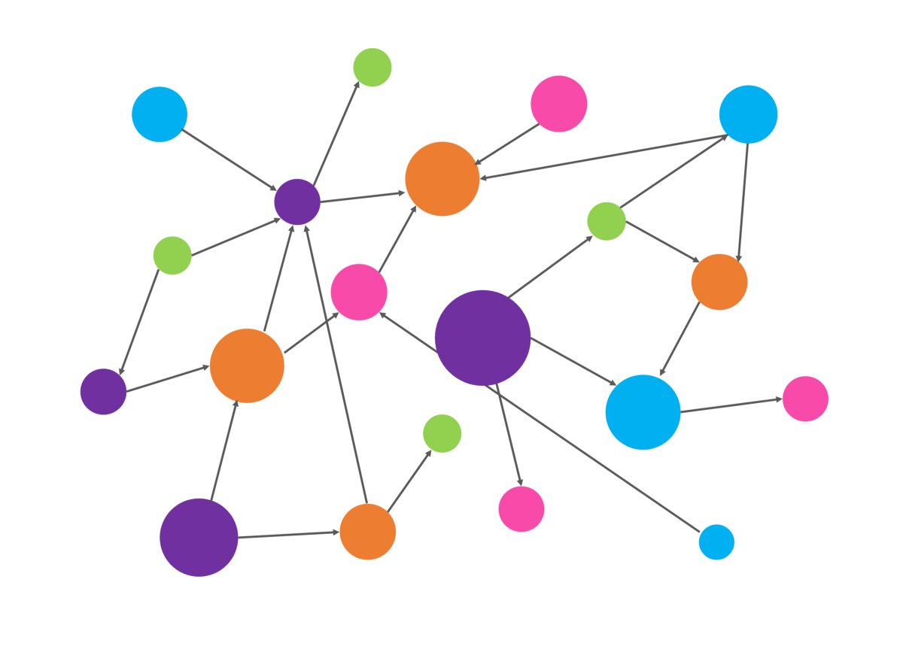
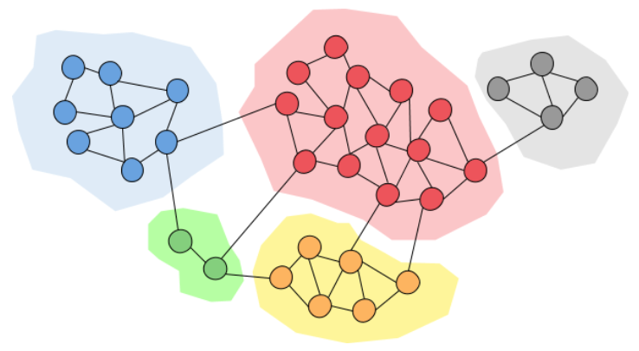
Fraud Detection on Unstructured Data using KG
.
.
.
.
.
.
.
.
.
.
.
.
.
.
.
.
.
.
.
.
Multiple Documents to KG
Fraud Detection using KG
Single Document to KG
Sri Hari
Narendra
Deepam

Slide 3
INTERIM REVIEW
SRIHARI THUNGA,
IIMSC Data Science and Computing,
SSSIHL,
MDH Campus.
Guided By:
SRI P.SUNIL KUMAR SIR,
Assistant Professor,
Dept of Mathematics and Computer science,
SSSIHL,
MDH campus.

Slide 4
Problem Statement:
Building knowledge-Graph on abstractive text summary of a single document.

Slide 5
Introduction
1)A knowledge graph represents a network of real-world entities i.e. objects, events, situations, or concepts and illustrates the relationship between them.
2)This information is usually stored in a graph database and visualized as a graph structure, prompting the term knowledge “graph.”

Slide 6
Circles:Named entities,
Edges : Relationship
Ram
Cricket
plays
Speaks
Father
Telugu
Dasaratha

Slide 7
1)A knowledge graph is self-descriptive, as it provides a single place to find the data and understand what it is all about.
2)The meaning of the data is encoded alongside the data in the graph itself.
3)Explainability: Large networks of entities and relations provide solutions for the issue of understandability by integrating the meaning of entities available within the graph itself.

Slide 8
Literature Review
1)Text Summarization Techniques: A Brief Survey.
2)Abstractive Web News Summarization Using Knowledge Graphs.
3)Key Phrase Extraction Using Knowledge Graphs.
4)BART: Denoising Sequence-to-Sequence Pre-training for Natural Language Generation, Translation, and Comprehension.
5)Text Summarization Using Facebook BART large CNN.

Slide 9
Output Of Literature Review
BART Summarization
Rule based dependency parsing
Extracting Triples
Building KG

Slide 10
BART Summarization
Summarization?
1)In a short paragraph understanding the whole text document.
Types of summarizations?
1)Extractive summarization.
2)Abstractive summarization.

Slide 11
What Is BART?
1)BART is a transformer encoder-encoder (seq2seq) model with a bidirectional (BERT-like) encoder and an autoregressive (GPT-like) decoder.
2)BART is pre-trained by (a) corrupting text with an arbitrary noising function, and (b) learning a model to reconstruct the original text.

Slide 12
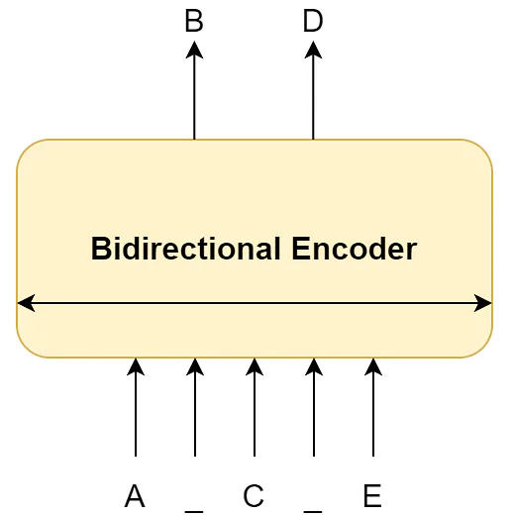
BART Architecture

Slide 13
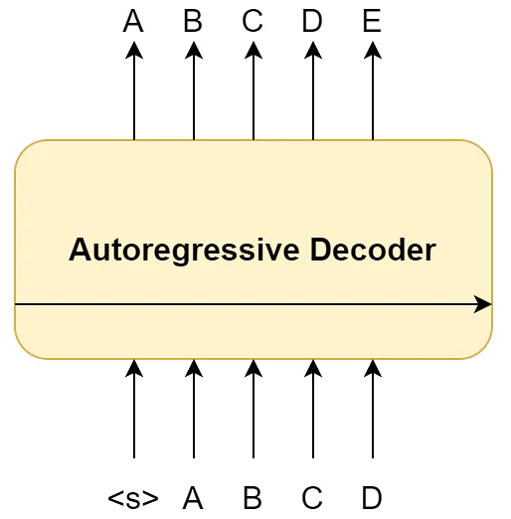

Slide 14
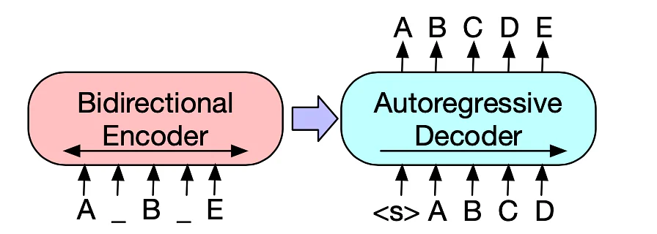

Slide 15
Tools
1)Google Colab
2)Visual Studio
3)Neo4j
4)Python
5)Cypher

Slide 16
Futurework
Replicating the same work on legal government documents downloadable from Government portals. *(Dec-Jan)
Documentation *(Feb-Mar)
Notes:
Replicate work on legal docs

Slide 17

DEMO

Slide 18
Time Line
1)The Rise Of Knowledge Graph(Book). *(Aug)
2)Knowledge Graph Seminar Seasonal Videos. *(Sep)
3)Neo4j tutorials. *(Oct)
4)Standford NLP lectures. *(Nov)

Slide 19
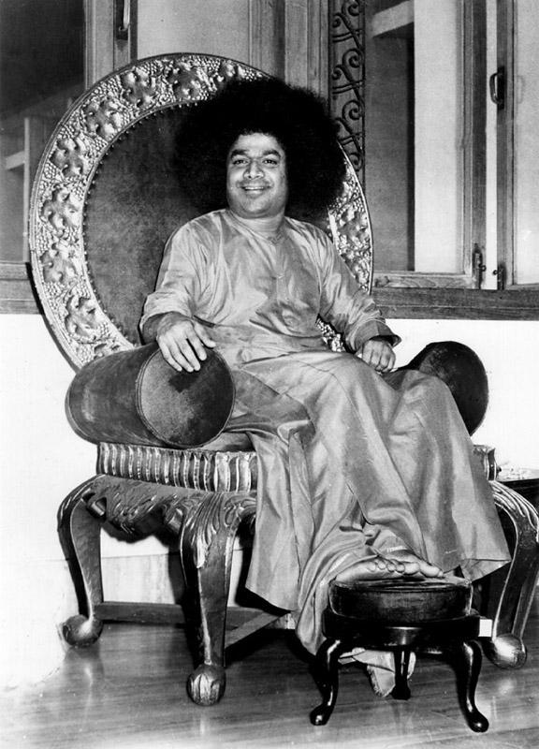
Project Interim Review
Narendra Kumar Reddy,
II M.S.C Data Science and Computing,
SSSIHL.
Guided By:
Sri P. Sunil Kumar,
Assistant Professor,
Dept. of Mathematics and Computer Science,
SSSIHL.

Slide 20
Problem Statement
Generating a Knowledge Graph from Linked summary documents.

Slide 21
Introduction
Often documents refer to each other (e.g.Web documents,Government documents etc.).
To fetch the right document given a current task at hand and to keep track of all the changes in the documents (and the relationship between documents) over time, it is necessary to link these long documents efficiently and extract the summary out of it.
Individual knowledge graphs generated from each document can be merged and form a single knowledge graph which can be used as a summarized input for further processing.

Slide 22
Literature Review
Text Summarization Techniques: 28 July 2017
Knowledge Graphs and Deep Neural Network for Extractive Text Summarization by Utilizing Triples: December 2020
Collective Multi-type Entity Alignment Between Knowledge Graphs: April 2020
BERT : Pre-training of Deep Bidirectional Transformers for Language Understanding: 24 May 2019
NER_BERT : A Pre-trained Model for Low-Resource Entity Tagging: 1 December 2021

Slide 23
Challenges
Understanding linked documents is complicated.
To merge them which is even more complicated.
Knowledge graphs solves this problem easily.
Merge each document’s knowledge graph for next level input

Slide 24
Title: Generating a Knowledge Graph from Linked Documents.
Overview: Generating a knowledge graph from linked legal documents (NITI Aayog) using NLP, KG, GNN, and GCN to keep track of all the changes in the documents over time.

Slide 25
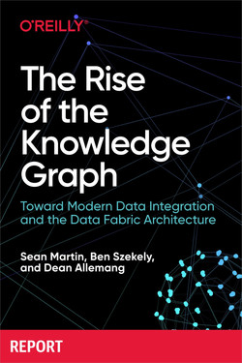

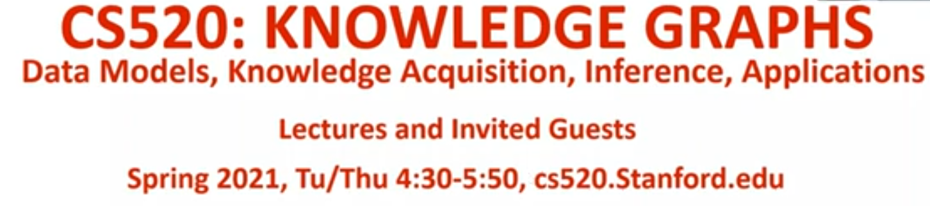
Learning

Slide 26
Pipeline
Documents
Triples Extraction
Knowledge Graphs
Merged Knowledge Graph
BERT
Python, Neo4j
GNN, GAT
Merge KGs
NER, Corref, …
For further processing

Slide 27
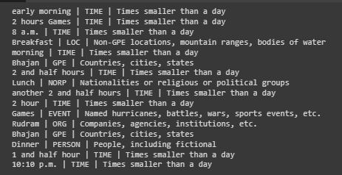
NER

Slide 28
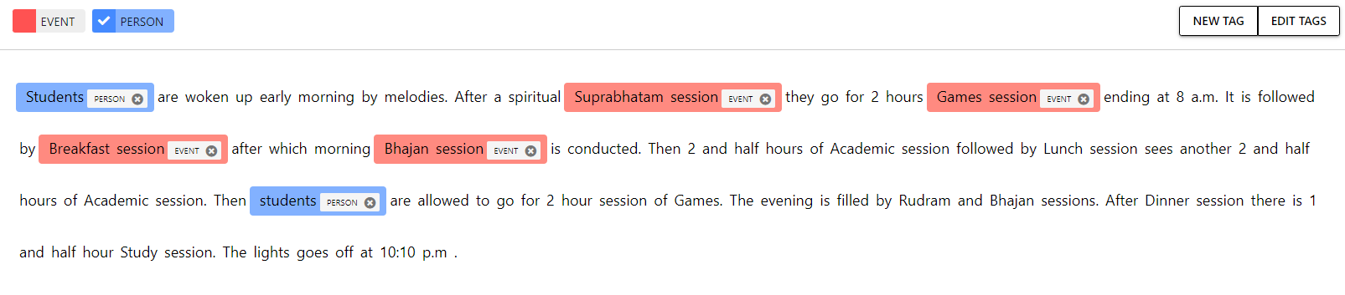
Customize NER
This is done by using a tool called NER annotator - https://tecoholic.github.io/ner-annotator/

Slide 29
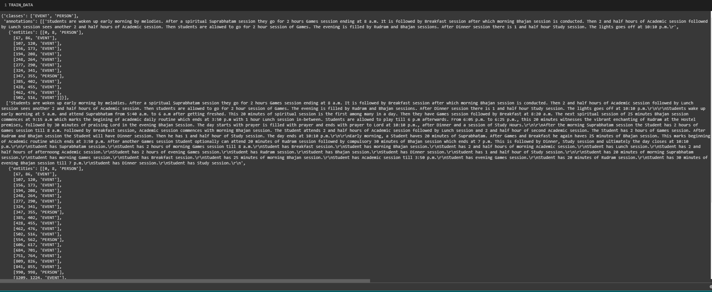

Slide 30
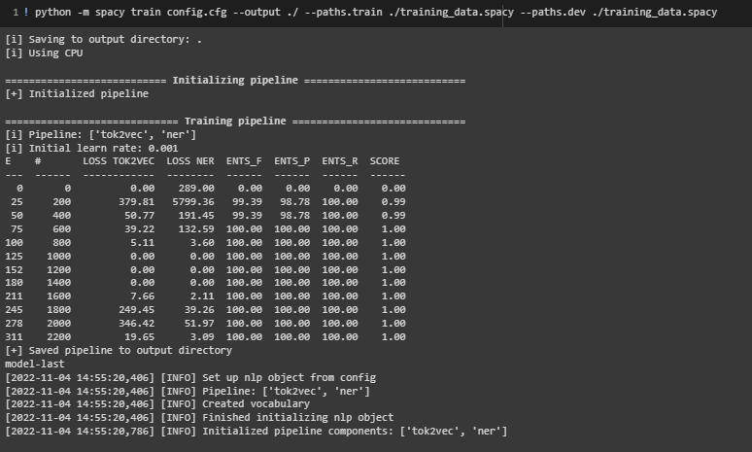
Training on annotated data

Slide 31
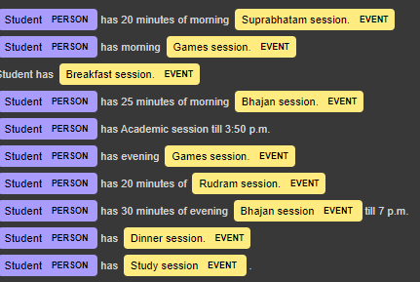
Customized NER Results

Slide 32
Coreference Resolution
Spacy Hugging-face Neural Coref
Although he was very busy with his work, Peter had had enough of it. He and his wife decided they needed a holiday. They travelled to Spain because they loved the country very much.
Students are woken up early morning by melodies. After a spiritual suprabhatam session they go for 2 hours games session ending at 8 a.m. It is followed by breakfast session after which morning bhajan session is conducted. Then 2 and half hours of academic session followed by lunch session sees another 2 and half hours of academic session. Then students are allowed to go for 2 hour session of games. The evening is filled by rudram and bhajan sessions. After dinner session there is 1 and half hour study session. The lights goes off at 10:10 p.m.
Notes:
Correrence resolutions disambiguate the entities.

Slide 33
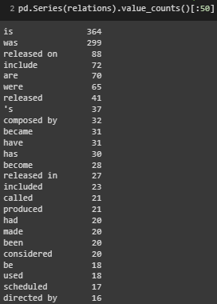
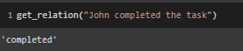
Dependency Parsing

Slide 34
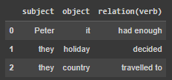
KG Generation

Slide 35
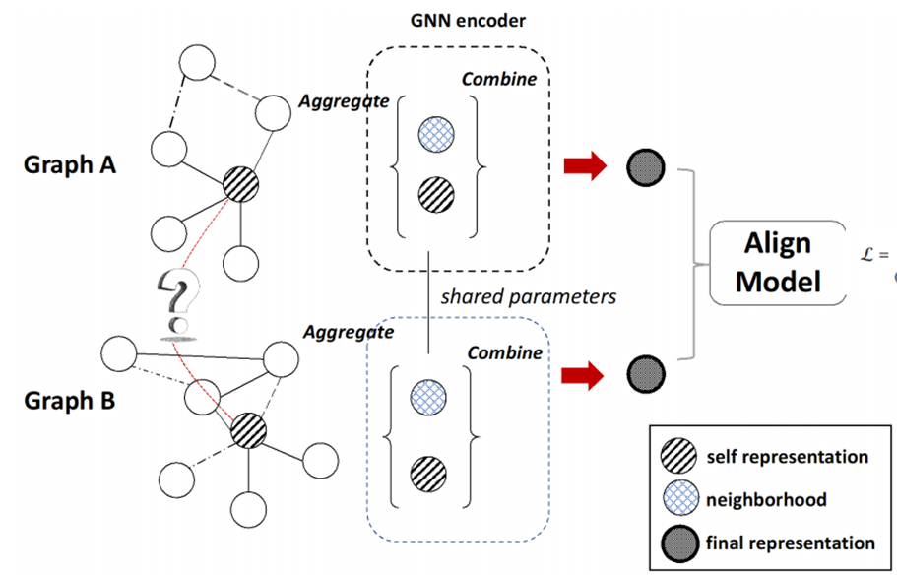
Presentation - GNN

Slide 36
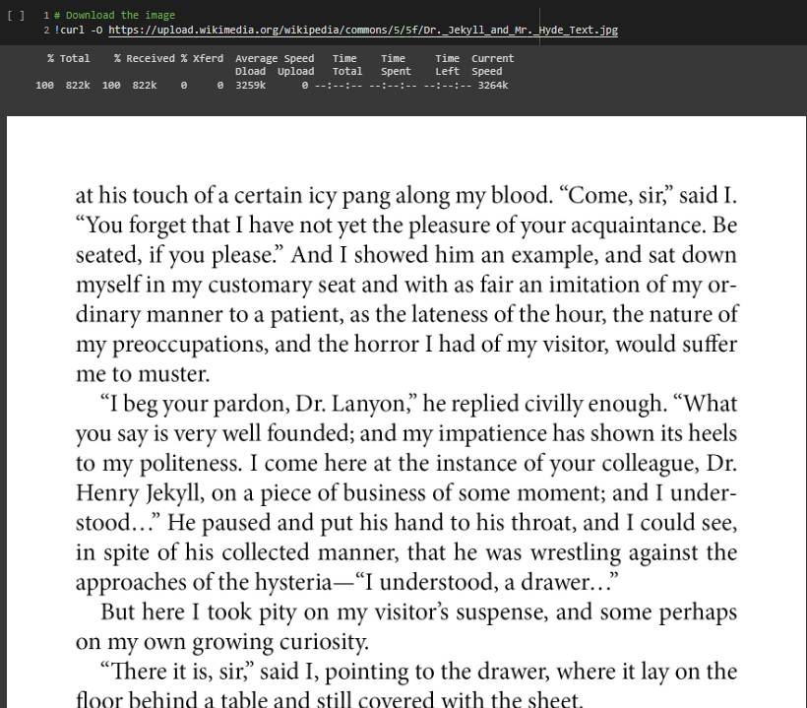
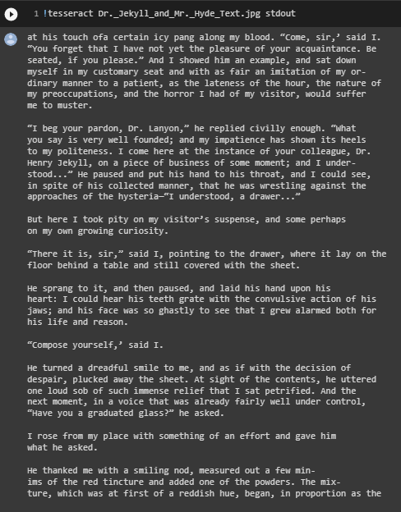
Pdf to text
Apache Tika

Slide 37
Timeline
July
August
September
October
November
Videos on KG
Pipeline for text to KG
Book
Triples Generation
NLP Basics
Neo4j
NER
Coreference Resolution
GNN, GAT
RNN, LSTM
BERT, NER-BERT
The Rise of Knowledge Graph
Research Paper
Cs520.stanford.edu
Path to convert text to kG
Articles
Neo4j website
Spacy v3 model Text Annotation NeuralCoref
University of Trento Blogs Research Papers

Slide 38
Future Timeline 2023
January
February
March
April
Testing on legal Documents to KG
Integrating KGs
Documents summarization
Integrating with Fraud detection Analysis
Documentation
GNN, GAT Coding
BERT
Ayushman Bharat downloadable Documents
https://ayushmanup.in/pages.aspx?pt=GOI-Guidelines
Fraud Rings - Neo4j
Rule & Model Based Fraud Detection
Project Report

Slide 39
Tools
Apache Tika: To read text from pdf files.
NER Annotator: To create annotation files for entities (custom Ner).
Spacy: hugging face (Neural Corref), NER, Dependency Parser.
BERT
Neo4j
Cypher Query Language
Graph Neural Networks (GNN)
Graph Attention (GAT)

Slide 40


Slide 41
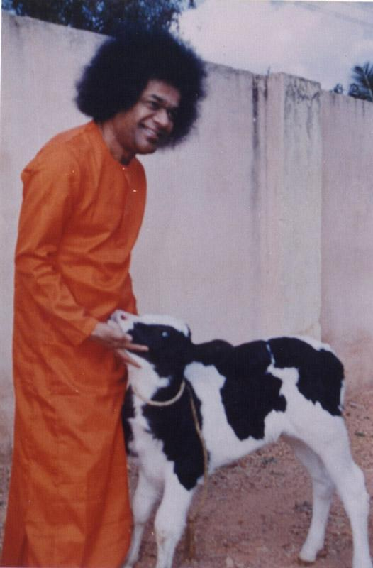

Interim Review
21231
Deepam Rai
II MSC

Slide 42
Problem Statement:
Detecting possible frauds in relevant domains using GANs and KG.

Slide 43
Motivation
Federal Trade Commission
https://www.ftc.gov/news-events/news/press-releases/2022/02/new-data-shows-ftc-received-28-million-fraud-reports-consumers-2021-0
~ $16 million per day
~ ₹131 crore per day

Slide 44
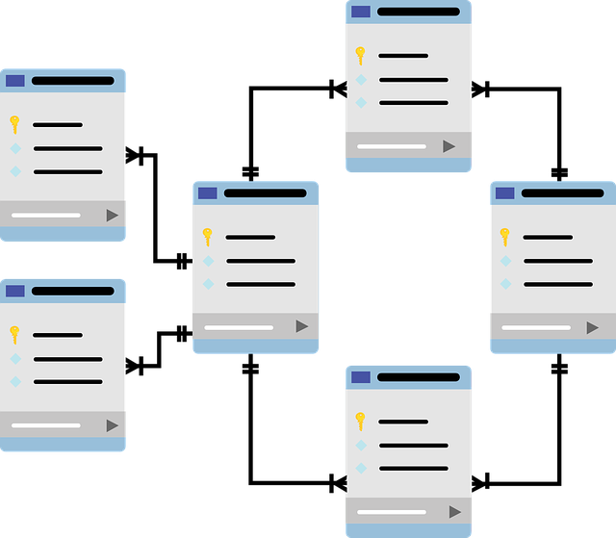
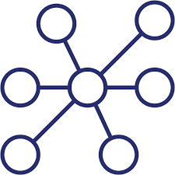
Why KG?
Difficult to analyze.
Expensive scalability.
Data is not always structured.
Can write rules but how many?
Intuitive Analysis.
Highly Scalable.
Best for Unstructured data.
Best for Ad-Hoc queries, global Algorithms.

Slide 45
Basic Idea
Queries
Data
.
.
KG
Analysis & Fraud Detection

Slide 46
Literature Review
Papers
Text Summarization Techniques: A Brief Survey
Mehdi Allahyari et. al. -2017
DC-Art-GAN: Stable Procedural Content Generation using DC-GANs for Digital Art
Rohit Gandikota, Nik Bear Brown - 2022
Medical Knowledge Graph to Enhance Fraud, Waste, and Abuse Detection on Claim Data: Model Development and Performance Evaluation Li Hou, Jiao Li et. al. - 2020
Identifying Linked Fraudulent Activities Using Graph Convolution Network
Sharmin Pathan, Vyom Shrivastava - 2021
Behavioral graph fraud detection in E-commerce
Hang Yin, Zitao Zhang - 2022
Courses:
Neo4j fundamentals by Neo4j Graph Academy
CYPHER fundamentals by Neo4j Graph Academy
Stanford University Knowledge Graphs by Prof. Dr. Harald Sack, Dr. Mehwish Alam

Slide 47
Output of Literature Review
High level workflow of Fraud Detection using KG
GANs for Data Generation
End-to-End pipeline for Fraud Detection using KG

Slide 48
High Level Workflow for Fraud Detection
High Precision Low Recall
KG Schema
Fraud
Rule Based
Unscalable
DL
Knowledge
Graph
Model Based
High Recall
Low Precision
Data
.
.
Fraud
Scalable

Slide 49
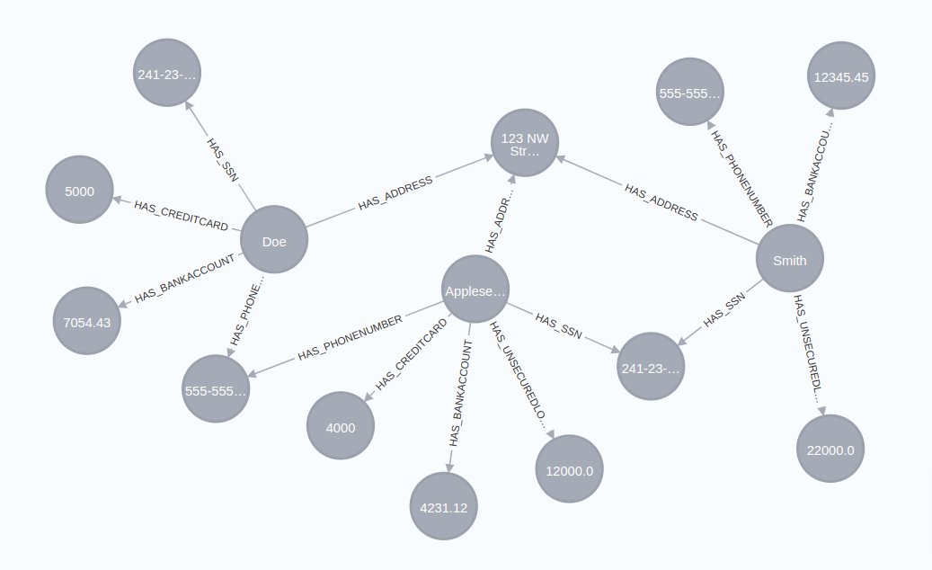
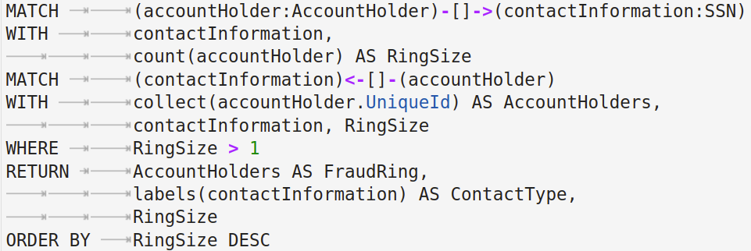
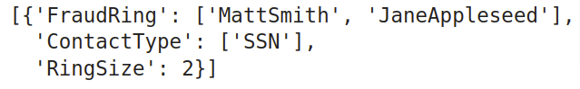
Rule Based - Query type
Notes:
Captures Local Information.
Specific to use cases and Data.

Slide 50
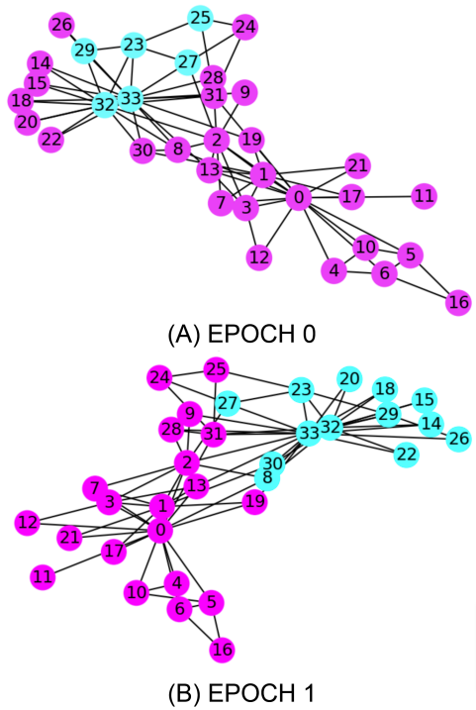
Rule Based - Graph Algorithms
Louvain Label Propagation
Non-Fraudulent
Fraudulent
Notes:
Captures global pattern.
Community detection, centrality, embeddings, centrality, etc
Louvian, GraphSAGE, etc.
Non-specific to data.

Slide 51
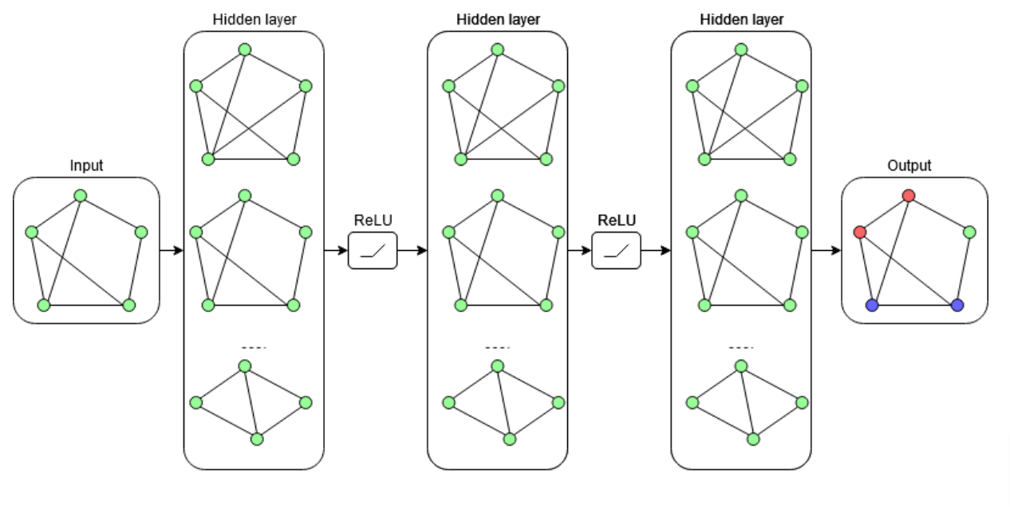
Model Based - GCN
Identifying Linked Fraudulent Activities Using Graph Convolution Network
Sharmin Pathan, Vyom Shrivastava - 2021
Notes:
Good results even with less fraud data.

Slide 52
GANs - For data generation
Fraud Data
Non-Fraud Data
Typically ~5%
Pros:
Good result quality.
No need to specify likelihood functions.
Cons:
Highly sensitive to hyper-parameters.
Mode collapse.
Unknown distribution of data.
Notes:
SMOTE looks for local information while GANs looks for overall class distribution.

Slide 53
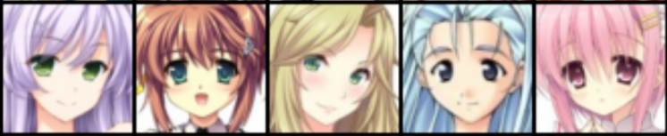
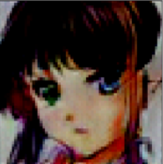
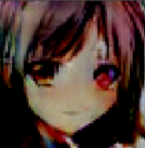
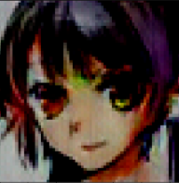
GANs - Work
Real Data
Generated Data
DCGAN
64x64 Images of 3 Color channels
9 Layers Generator Architecture
~2Hr Training on Google Colab GPU

Slide 54
Complete flow
Fraud
KG Schema
Future Predictions
Graph Algos
1. Hierarchies
2. Influential Points, Paths
Knowledge
Graph
Integrate in ML Algos
DL,ML..
Rule Based
Fraud
with
Structure
Extracted
Important Features
Soft Links
Extract Node & Relationship Properties
Fraud
Rings
Model Based
Data
GAN generated Fraud Data
GAN

Slide 55
Tools
Libraries:
icypher
neo4j
neo4jupyter
networkx
py2neo
pytorch
scipy
pickle
Languages:
Python
Cypher
Platform:
neo4j

Slide 56
Timeline - …Till Now
July
August
September
October
November
Knowledge Graph
Neo4j, CYPHER,...
GANs
Fraud Detection
Fraud Detection
KG Course
Neo4j courses
CYPHER courses
Book: GANs in Action
GANs literature
Literature
Rule Based Methods
Graph Data Science
GNN, GCN,..

Slide 57
Timeline - Now on…
January
February
March
April
May
Model Based Methods &
Graph Algos
Coding and Debugging
End-to-End Fraud Detection Pipeline
Paper and Thesis
GNN, GCN,...
Louvian, GraphSage, etc
KG-GAN
Specifically oriented towards legal documents.
Social Security Domain - Ayushman Bharat
Fraud Detection
Generalization
Extract Features
Prediction

Slide 58
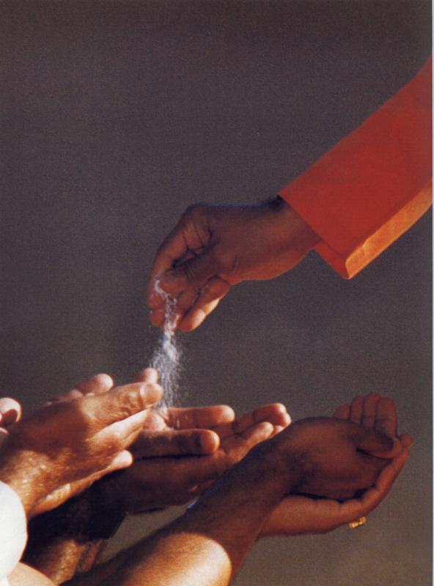
We are very much thankful to
Our Mentor Sir P. Sunil Kumar
for guiding us and providing us with the required resources.
Brother Anil Kumar Reddy
for guiding us through the landscape of tools and techniques and helping us in every step.
Sri P. V. S. Prakash
providing us with extensive workshop on Deep Learning.
…To Swami we are ever grateful

Slide 59
Thank You
Sairam

